Slide 1


Content Area Teacher Training (CATT)
Modifying and Developing Materials
Day Two
PowerPoint Developed by Tara Chandler and Tory Hunziker, CESL

Slide 2
Today’s Agenda
Contextualizing Key Vocabulary (SIOP article)
Read and do activities
Processing Language Through Content article
Read and do activities

Slide 3

Remember: you are learning as you are doing

Slide 4
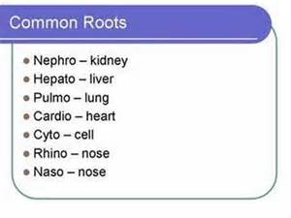
SIOP: Feature 9 Key Vocabulary Emphasized pp. 68-82
Strong vocabulary instruction is essential.
Identify key words and provide repeated exposure.
You are the expert.
Three kinds of vocabulary
Content vocabulary
General academic vocabulary
Word parts: roots and affixes

Slide 5
SIOP: Feature 9 Key Vocabulary Emphasized pp. 68-82
Building Background Knowledge
Pages 76-82 offer ideas for activating background knowledge.
Use before (and I argue while) learning new concepts
Examples on the following slides

Slide 6
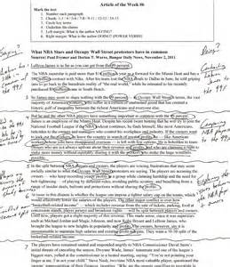

SIOP: Feature 9 Key Vocabulary Emphasized Building Background Knowledge
Read aloud and digital jumpstarts
About the topic
Insert method and other annotations
Symbols and numbers
Word clouds

Slide 7
Contextualizing key Vocabulary (SIOP 79) Using Prensky’s Article
We now use digital sources instead of paper.
The native people have lived here for much longer than anyone else.
The immigrants, those who were not born here, now live, work, go to school, and call this place home.
Directions: Read the first page of the article (and finish the sentence on the 2nd page). Summarize the main idea of the page.

Slide 8
If students need more help…
Ask leading questions using the key vocabulary to bring them to the main idea.
What is a digital native?
How do digital natives think?
What digital devices do they use?
Have people always used these devices?
What has changed?
What is a digital immigrant?
“Now, think about the answers to those questions. What is the main idea of this page?”

Slide 9
If students need even more help…
Remind students that they don’t have to understand EVERY word on the page to understand the main idea.
Add pictures to help contextualize the words when you first introduce them.
Now finish reading the Prensky article.

Slide 10
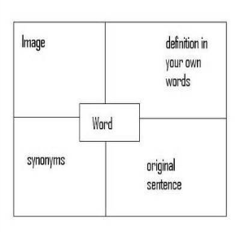
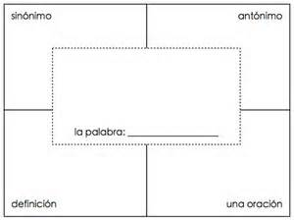
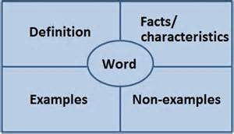
Four Corners Vocabulary Chart
Instead of using class time to contextualize key vocabulary, you can assign students a vocabulary assignment before class using this strategy. (SIOP p. 81)
Directions: Do a four corners vocabulary chart for 1 of these four words: digital, native, immigrant, change. Or any other word you learned.
Other options: Cloze sentences (p. 82), translation, cognate, copy sentence from reading, make new sentence, breaking the words into syllables, etc.

Slide 11
Discussion
Read SIOP pp. 76-82. Make notes on each: I’ve used it, this might work, this probably won’t work, not worth the effort
Which vocabulary strategy from the SIOP (pp.76-82) article might work best for your students? Why?
How can you implement one (or more) of these strategies to one of your lessons?
Is there a vocabulary strategy that would not work well for your classes? Why not?
What other thoughts and reactions do you have about the SIOP article you read on vocabulary strategies? Did you find another strategy from the reading that you think would be helpful?

Slide 12
Activity
Add words to our CATT word wall

Slide 13
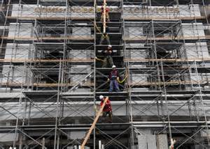
Processing Language Through Content pp. 59-61, 71-73, 85-86
Comprehensible input
Learners should understand what they hear
Stephen Krashen: i + 1
Use context and extralinguistic information
Jerome Bruner: scaffold up and down

Slide 14

Processing Language Through Content pp. 59-61, 71-73, 85-86
Stephen Krashen’s Theory of Comprehensible Input
http://www.sk.com.br/sk-krash.html

Slide 15
Comprehension
Scan the main paragraph on page 60 of the Lyster article and highlight or underline all of the methods teachers can use to make input more comprehensible for students.
Which of these methods do you already use? Which ones would you like to incorporate? Discuss with a partner.

Slide 16
Comprehension
Think about all of the methods you just highlighted.
In what order would you put them to successfully scaffold language and content?
Partner Discussion

Slide 17
Comprehension
Read the main paragraph on pp. 61 of the Lyster article.
Be prepared to discuss the answers to these questions:
What is the consequence of not continually moving up to the next level of comprehension?
How could (and should) this effect our methods of teaching as a semester progresses?

Slide 18
Production pp.71-72
Read and annotate the section on production
How many different arguments are made?
Discuss each argument and identify its strengths, weaknesses, and validity.

Slide 19
Summary
Vocabulary instruction is imperative
You can introduce new ideas and materials in pieces (like your readings of Digital Natives, Digital Immigrants today, and your introduction to Lyster 2007)
Consider ways to make materials more comprehensible for your learners

